Slide 1
What is a Probability Distribution?
A probability distribution is a mathematical function that provides the probabilities of the occurrence of various possible outcomes in an experiment. Probability distributions are used to define different types of random variables in order to make decisions based on these models. There are two types of random variables: discrete and continuous. Depending on what category the random variable fits into, a statistician may decide to calculate the mean, median, variance, probability, or other statistical calculations using a different equation associated with that type of random variable. This is important because, as experiments may become more complicated, the standard formulas that are used to calculate these parameters (like the mean) will no longer produce accurate results.

Slide 2
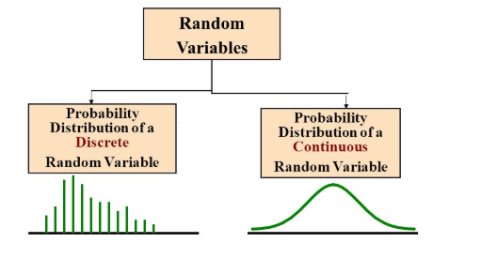
What is Probability Distribution?
Probability Distribution is a statistical function which links or lists all the possible outcomes a random variable can take, in any random process, with its corresponding probability of occurrence.
Values of random variable changes, based on the underlying probability distribution.
It gives the idea about the underlying probability distribution by showing all possible values which a random variable can take along with the likelihood of those values.

Slide 3
Let X be the number of heads that result from the toss of 2 coins. Here X can take values 0,1, or 2. X is a discrete random variable.
The table below shows the probabilities associated with the different possible values of X.
The probability of getting 0 heads is 0.25, 1 head is 0.50, 2 heads is 0.25.
Simple example of probability distribution for a discrete random variable.
Probabilities distribution of random variable X
Probability Distribution for the above example

Slide 4
Need of Probability Distribution
According to the definition of random variable, it’s the variable which can hold different set of values from the outcome of any random process. However, it lacks the capability to capture the probability of getting those different values.
So, probability distribution helps to create a clear picture of all the possible set of values with their respective probability of occurrence in any random process.

Slide 5
Classification of Probability Distribution
Discrete Probability Distributions
Continuous Probability Distributions
Binomial Distribution
Poisson Distribution
Geometric Distribution
Negative binomial Distribution
Uniform Distribution
Exponential Distribution
Gamma Distribution
Normal distribution

Slide 6
Example: Rolling of a Dice. If X is a random variable associated with the rolling of a six-sided fair dice then, PMF of X is given as:
PMF

Slide 7
Binomial Distribution
Let’s get back to cricket. Suppose that you won the toss today and this indicates a successful event. You toss again but you lost this time. If you win a toss today, this does not necessitate that you will win the toss tomorrow. Let’s assign a random variable, say X, to the number of times you won the toss. What can be the possible value of X? It can be any number depending on the number of times you tossed a coin.
There are only two possible outcomes. Head denoting success and tail denoting failure. Therefore, probability of getting a head = 0.5 and the probability of failure can be easily computed as: q = 1- p = 0.5.
A distribution where only two outcomes are possible, such as success or failure, gain or loss, win or lose and where the probability of success and failure is same for all the trials is called a Binomial Distribution.
The outcomes need not be equally likely. Remember the example of a fight between me and Undertaker? So, if the probability of success in an experiment is 0.2 then the probability of failure can be easily computed as q = 1 – 0.2 = 0.8.

Slide 8
Each trial is independent since the outcome of the previous toss doesn’t determine or affect the outcome of the current toss. An experiment with only two possible outcomes repeated n number of times is called binomial. The parameters of a binomial distribution are n and p where n is the total number of trials and p is the probability of success in each trial.
On the basis of the above explanation, the properties of a Binomial Distribution are
Each trial is independent.
There are only two possible outcomes in a trial- either a success or a failure.
A total number of n identical trials are conducted.
The probability of success and failure is same for all trials. (Trials are identical.)

Slide 9

The mathematical representation of binomial distribution is given by:
The mathematical representation of binomial distribution is given by:

Slide 10
A binomial distribution graph where the probability of success does not equal the probability of failure looks like

Slide 11
Now, when probability of success = probability of failure, in such a situation the graph of binomial distribution looks like

Slide 12
The mean and variance of a binomial distribution are given by:
Mean -> µ = n*p
Variance -> Var(X) = n*p*q

